Slide 1
Digital Connect
Mentor Upskill Training
Password Management
3 July 2025

Slide 2
Agenda
Why do we need to manage passwords?
What is a Password Manager
Password vs Passkey
Apple and Android password managers
Practice!
Things to remember
Resources
Discussion

Slide 3
Why do we need to worry about Passwords?
Passwords are the primary method of securing access to our digital lives
It's crucial to treat them with care because compromised passwords can lead to serious consequences, including identity theft, financial loss, and reputational damage.
Weak passwords or reused passwords across multiple sites make it easier for malicious actors to gain unauthorised access to personal information, accounts, and devices.
Notes:
Passwords are the primary method of securing access to our digital lives, and it's crucial to treat them with care because compromised passwords can lead to serious consequences, including identity theft, financial loss, and reputational damage. Weak passwords or reused passwords across multiple sites make it easier for malicious actors to gain unauthorized access to personal information, accounts, and devices.
Why are passwords important?
Protection of Sensitive Information: Passwords act as a barrier, safeguarding our personal data, financial information, and online accounts from unauthorised access.
Prevention of Identity Theft: A compromised password can be used to steal your identity, leading to fraudulent activities, financial losses, and damage to your reputation.
Maintaining Account Security: Strong, unique passwords are the first line of defense against cyberattacks like brute-force attacks and phishing attempts.
Avoiding Financial Loss: Compromised passwords can lead to unauthorized access to bank accounts, credit card details, and other financial information, resulting in significant financial losses.
Protecting Online Reputation: Damage to your online reputation can occur if a compromised password is used to post inappropriate content or engage in malicious activities.
Preventing Account Takeover: If a password is stolen, malicious actors can take over your online accounts, potentially using them for various harmful purposes.

Slide 4
Password Managers

Slide 5
What is a password manager?
A password manager is a tool that securely stores and manages your passwords and other sensitive login information, allowing you to easily access them across your devices and apps.
It helps you avoid the hassle of remembering multiple complex passwords and improves your overall online security.

Slide 6

So why use a password manager?
Stores passwords securely
Auto-fills login information
Generates strong passwords
Manages passkeys
Syncs across devices
Provides security alerts
Notes:
Stores passwords securely: Password managers use encryption to protect your passwords and other sensitive information, making them far more secure than storing them in plain text or reusing weak passwords.
Auto-fills login information: Automatically fill in your username and password when you visit websites or use apps, saving you time and effort.
Generates strong passwords: Can generate unique, strong, and complex passwords for each of your online accounts, which is crucial for security.
Manages passkeys: Store passkeys - a more modern and secure way to log in without passwords using biometrics or other device-specific methods.
Syncs across devices: You can access your saved passwords and login information on all your devices where you're logged into the password manager.
Provides security alerts: Can alert you if your passwords are found in data breaches or if you're using weak passwords.

Slide 7
Password vs Passkey

Slide 8
Passkeys explained
Let’s take a look
Chrome - https://www.youtube.com/watch?v=2xdV-xut7EQ
Microsoft
https://www.youtube.com/watch?v=bdp8RdjV6PU

Slide 9
What is a passkey?
A passkey allows you to sign in to an account on a website or app without having to enter a username or password or use multi-factor authentication.
Instead, it uses the same technology you use to unlock your device with a PIN, your fingerprint or face recognition, to access your account

Slide 10
How do passkeys work?
Think of passkeys as a pair of keys. One is a private key stored securely on your device or password manager, while the other is a public key held by a company’s website or app.
Your passkey acts as an authenticator that proves you are who you say you are. It can be stored on your smartphone, computer or tablet or a password manager, including built-in versions like iCloud Keychain on Apple devices or Google Password Manager on Android.
When you sign in to a website or app the two keys ‘talk’ to each other to verify your identity, when there’s a match they allow you access to your account.

Slide 11
Benefits of passkeys
Passkeys combat some of the frustrations that come with passwords, including having to create or memorise passwords each time you want to access your online accounts. Password managers are designed to help with this and are a secure option, however with passkeys no passwords are required and they’re not shared with the website or app you’re accessing.
One of the biggest benefits of passkeys is they are more secure than passwords. That’s because passkeys only work with the website or app they’ve been created for, meaning they won’t work with fake websites that try to capture your sign in credentials.

Slide 12
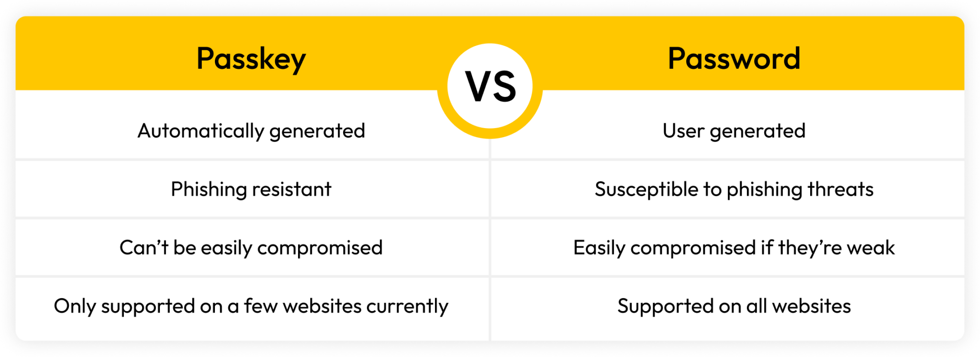
Passkey vs Password

Slide 13
Password Managers
available on your mobile device

Slide 14

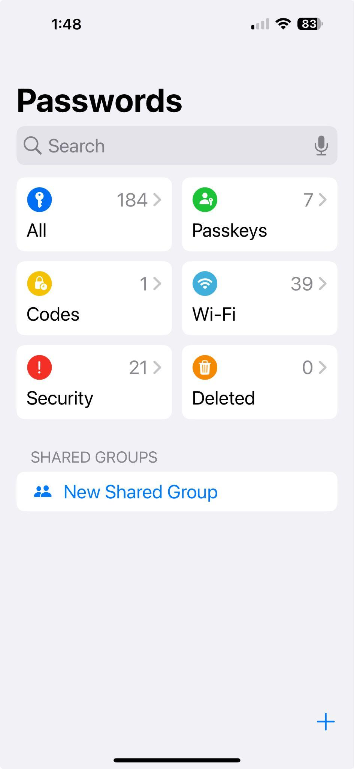
Apple
Passwords App previously known as ‘keychain’ in the Settings menu.
Some areas to get familiar with:
Passwords app
Settings > Apps > Passwords
Settings > General > Autofill & Passwords
Settings > Apple Account/ID > iCloud

Slide 15
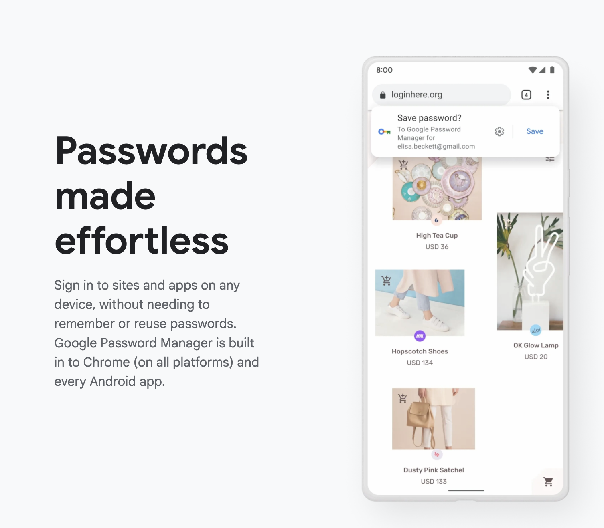
Android
Password manager within the Chrome app
Use the 3 little dots to access the ‘Google Password Manager’ - usually in the top right of your screen
https://passwords.google/

Slide 16
Let’s practice!

Slide 17
Things to remember

Slide 18
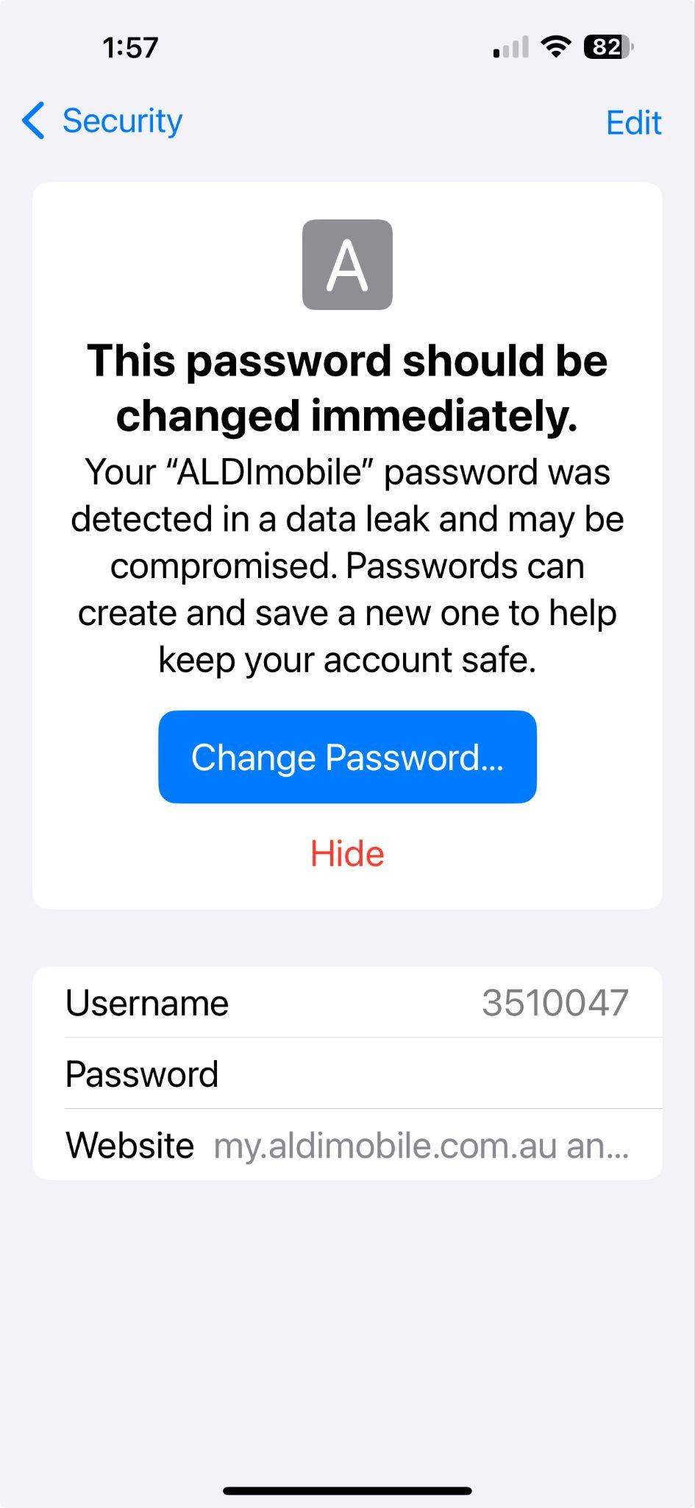
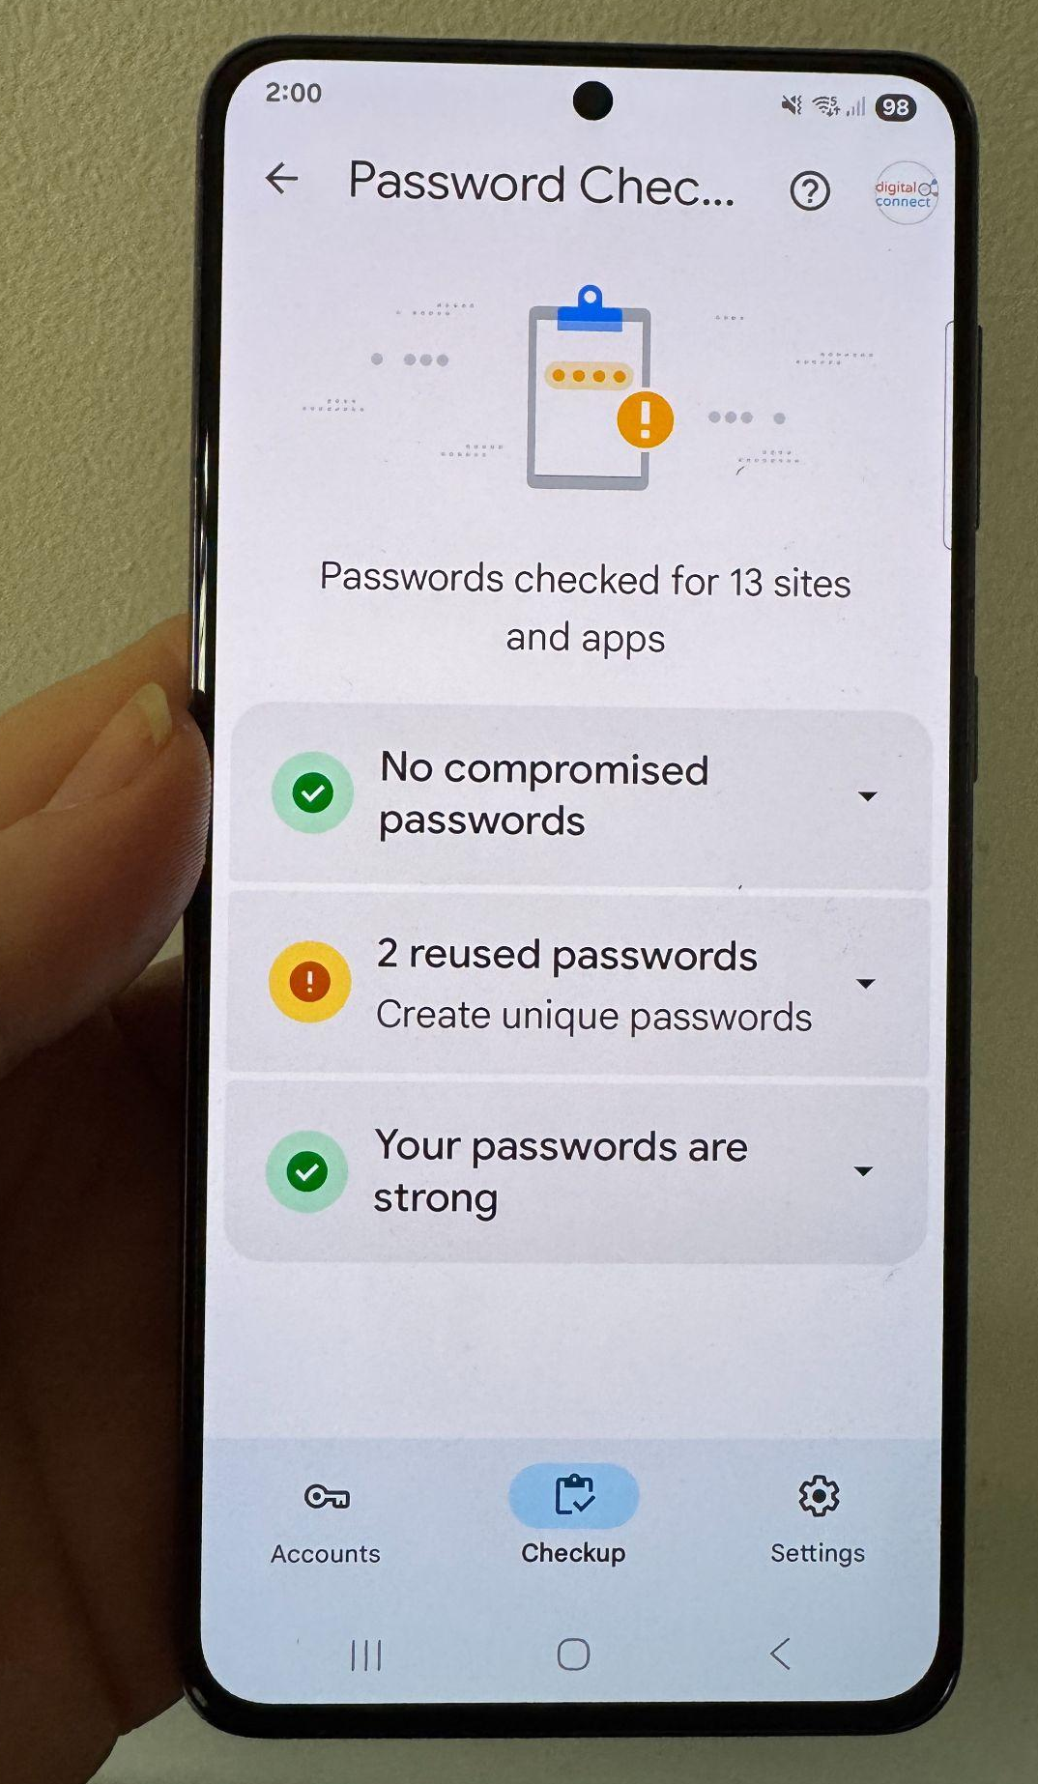
Common challenges / barriers
Resistance to change
Security concerns
Fear of setup / process
Password check up / alert prompts change on website - can be complicated

Slide 19
Before we tackle Password Managers next month
Passwords are a sensitive topic
Password management is complicated - remember the ‘frog’
What works for learners is ok. Our role is to build awareness and confidence.
Explain benefits / compared to what
Security concerns / scam prevention
Be comfortable with your own process / phone
If you aren’t sure, ask!

Slide 20
Resources
Be Connected:
https://beconnected.esafety.gov.au/topic-library/advanced-online-security/managing-passwords
https://beconnected.esafety.gov.au/topic-library/articles-and-tips/how-to-create-a-passkey-in-mygov
Apple Passwords App: https://support.apple.com/en-au/120758
Google Password Manager: https://passwords.google/
Passwords vs passkeys:
https://nordpass.com/blog/passkey-vs-password/
https://www.youtube.com/watch?v=QYdHm7zoF_M
https://www.youtube.com/watch?v=bdp8RdjV6PU Microsoft - simple explanation 3:54
https://www.youtube.com/watch?v=SF8ueIn2Nlc Chrome - passkeys simply explained

Slide 21
Discussion Time

